Slide 1


International Conference on Computational Performance Evaluation (ComPE-2020)
Ameliorated anti-spoofing application for PCs with users’ liveness detection using blink count
Paper ID - 197
Arpita Nema
Department of Computer Science and Engineering
Jabalpur Engineering College
Email – nemaarpita2012@gmail.com

Slide 2
Presentation Outline
Introduction
Related Approaches
Phases of proposed anti-spoofing application
Face Detection and Recognition
Liveness Detection
Ameliorated Functionality
Result Analysis
Conclusions
References

Slide 3

Introduction
Biometrics - the most advanced security solutions in the market.
Face recognition – Astonishingly versatile Biometric technology.
"Anti-spoofing application for PCs" is proposed in this work, .
Liveness Detection - mitigate the risk of video playback and forgery.
Ameliorated Functionality - Biometrics for security and security for biometrics.
Notes:
1 Biometrics offers greater security and convenience than traditional methods of personal recognition.
Face recognition dominates wide range of consumer application
Risks - Leaking a Biometric is a Disaster
Password leaked? Fine, you can easily replace with a new one.
Fingerprint leaked? Leaked for the rest of your life.
Lack of general solutions leaves this as a challenging issue.
cannot be forgotten, difficult to forge, and provides a very strong access control security solution satisfying authentication, confidentiality, integrity, and non-repudiation.
Due to the rapid growth in sensing and computing technologies, biometric systems have become affordable and are easily embedded in a variety of consumer devices (e.g., mobile phones, key fobs, etc.), making this technology vulnerable to the malicious designs of terrorists and criminals.
A framework is proposed to solve this problem

Slide 4
Related Works
Existing Desktop Security Applications
True key (Intel security)
Rohos Face Logon
FastAccess Anywhere
KeyLemon

Slide 5
Related Works
Methods to detect liveness in face recognition
3D Face Analysis
Pupil Tracking
Fourier spectra analysis predicated on hair
Recaptured feature extraction.

Slide 6
Phases of proposed anti-spoofing application
Face Detection and Recognition
Liveness Detection
Ameliorated Functionality

Slide 7
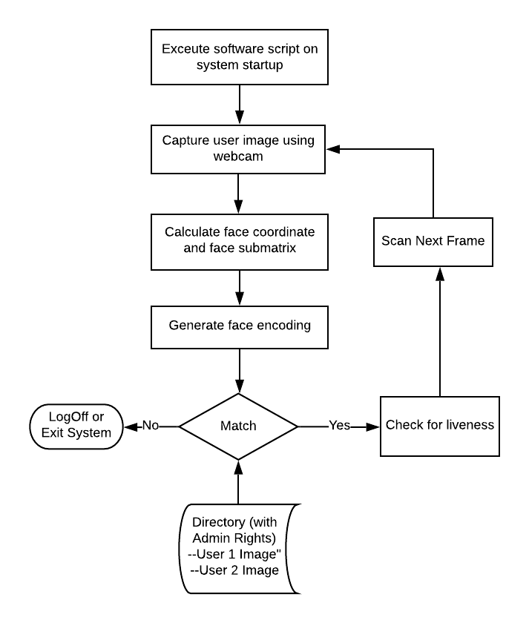
Face Detection
and
Recognition

Slide 8
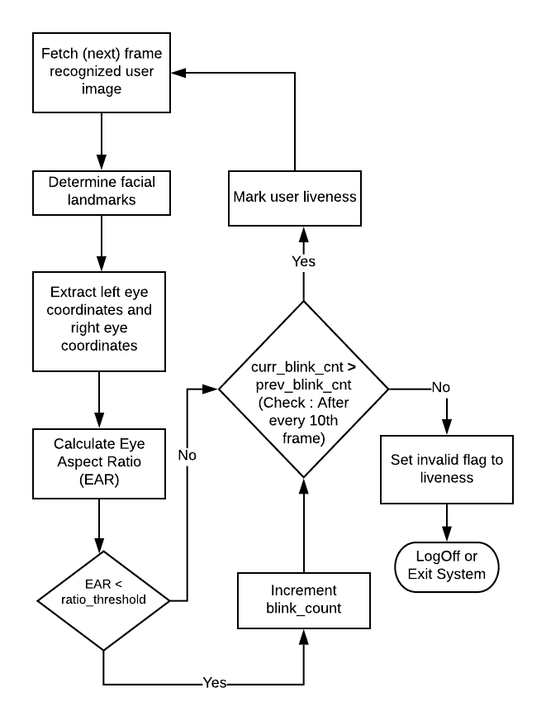
Liveness Detection
using
eye-blink count
External hardware not required.
User cooperation not required.

Slide 9
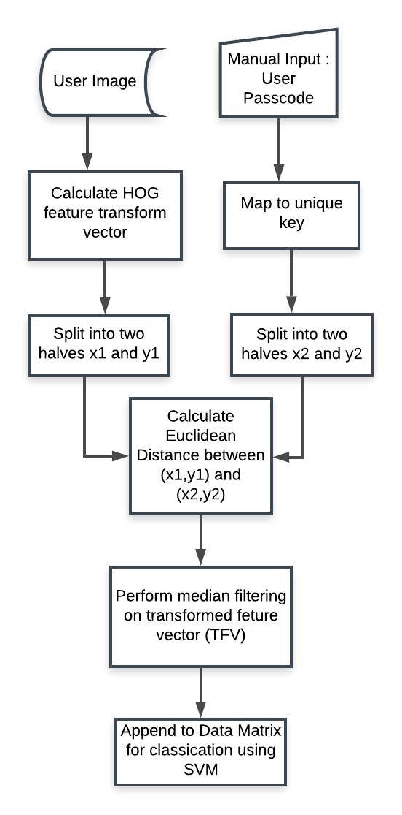
Ameliorated Functionality
Significant improvement in system performance.
Protect the stored biometric from leakage.
This approach works for other modalities as well.

Slide 10
Result Analysis
Dataset
ORL Database
10 Distinct facial images for each of the 40 individuals.
Images captured with varying face details and expressions and at different intervals of time.
CASIA Database
Contains 5-50 NIR and 1-22 VIS facial images for 725 individuals.
* Only VIS mugshot images are used to evaluate the performance here

Slide 11
Result Analysis
Performance Measure
The system’s performance is evaluated under three cases.
Case 1 - When each user uses a unique passcode
Case 2 - Same passcode is used by all users
Case 3 - When users’ original HOG features are used for classification

Slide 12
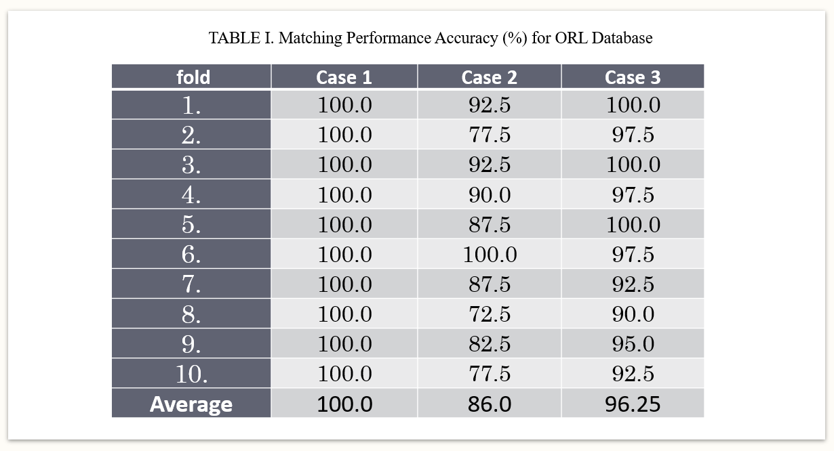
Result Analysis

Slide 13
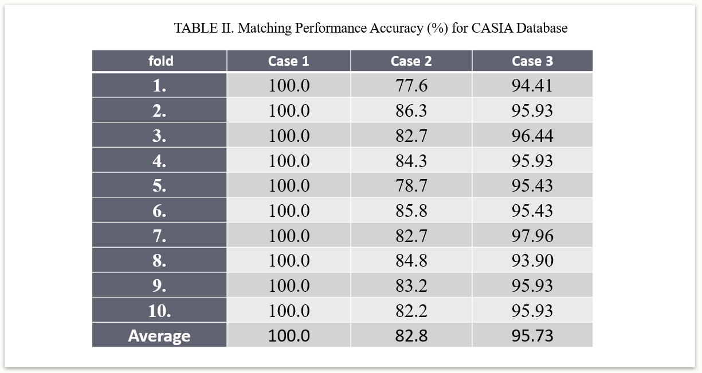
Result Analysis

Slide 14
Conclusion
Liveness detection using eye-blink count enhances the reliability of the face recognition application.
The approach proposed is a multi-platform application to enhance the security of the desktop system.
This is automatic and low-cost solution that does not require any user cooperation.
The application testing is conducted in varying conditions on authentic data that demonstrate the sturdiness and efficacy of the work proposed.

Slide 15
References
Sun Z., Hu K., Hu K., Liu J., Zhu K., “Fast Multi-Label Low-Rank Linearized SVM Classification Algorithm Based on Approximate Extreme Points”, IEEE Access, vol. 6, July 2018.
Wang H., Zhang D., Miao Z., “Fusion of LDB and HOG for face Recogntion”, IEEE, 37th Chinese Control Conference, Wuhan, China, July 2018
Luan X., Wang H., Ou W., Liu L., “Face lineness detection with recaptured feature extraction”, IEEE International Conference on Security, Pattern Analysis, and Cybernetics, Shenzhen, China, Dec. 2018.
Killioglu M., Taskiran M., Kahraman N., “Anti-Spoofing in Face Recognition with Liveness Detection Using Pupil Tracking”, IEEE 15th International Symposium on Applied Machine Inteeligence and Informatice, Herl’any, Slovakia, January 2017.
Weiwen Liu, “Face Liveness Detection using analysis of Fourier Spectra Based on Hair”, International Conference on Wavelet Analysis and Pattern Recognition, Lanzhou, July 2014.
Lagario A., Tistarelli M., Cadoni M., Fookes C., Sridharan S., “Liveness detection based on 3D face shape analysis”, International Workshop on Biometrics and Forensics, Lisbon, Portugal, April 2013.
3 Webcam Face Recognition Security Software and Biometric Password Manager, November 2019. Retrieved from https://www.geckoandfly.com/4068/webcam-face-recognition-security-software-and-password-manager-program/
Intel True Key. Retrieved from https://www.truekey.com/#features
Rohos Face Logon. Retrieved from https://www.rohos.com/products/rohos-face-logon/
Sensible Vision Patent , “System and method for providing secure access to an electronic device using continuous facial biometrics”, United States Patent, February 2013.
The Database of Faces, AT&T Laboratories Cambridge. Retrieved from http://cam-orl.co.uk/facedatabase.html
CASIA NIR-VIS 2.0 Database. Retrived from https://pythonhosted.org/bob.db.cbsr_nir_vis_2/

Slide 16
Thank You

Slide 17
Questions ?

